Slide 1


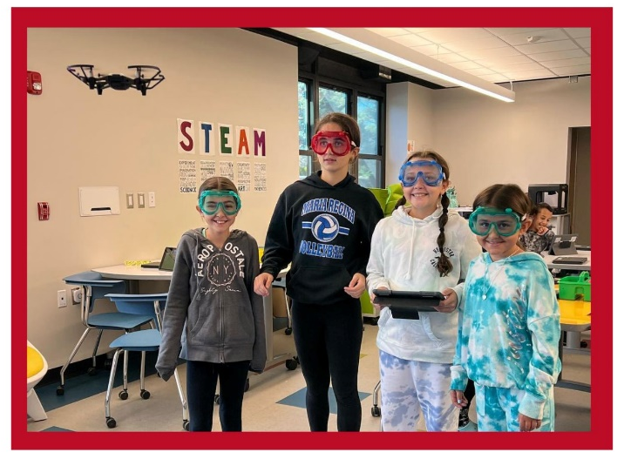
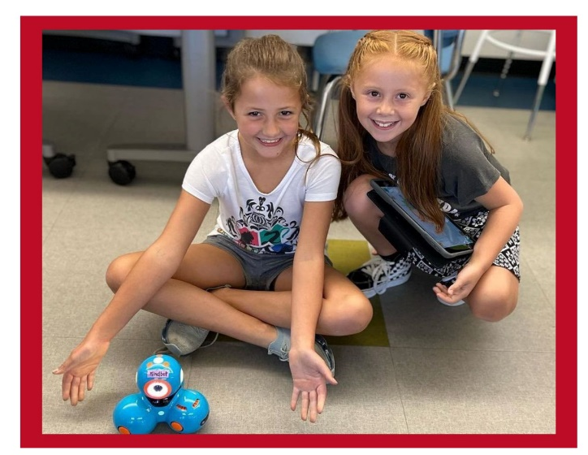
2023-2024
Foundation Aid
Spending
Plan

Slide 2


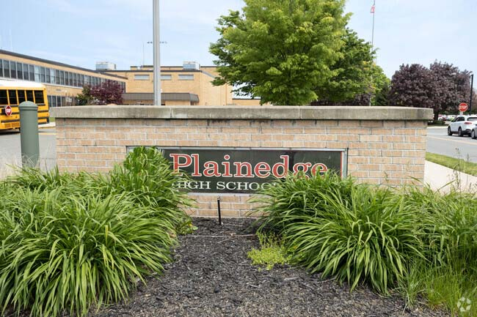

HOW WILL THE
PLAINEDGE SCHOOL DISTRICT UTILIZE THE FOUNDATION AID INCREASE IN 2023-24?
With the Foundation Aid Increase, the District will be able to assess and fund appropriate resources based on the needs of our students, including:
1. Increasing graduation rates and eliminating achievement gap:
The District's goal is to increase student achievement by implementing a positive behavior intervention and supports to track and improve behavior. (Total $20,000)
The Plainedge Union Free School District received a 23.8% or $3,233,147 increase in Foundation Aid for the 2023-24 school year.
2. Reducing class sizes:
The District's goal is to continue to keep low class sizes in our primary elementary grades. (Total $100,000)
3. Providing supports for students who are not meeting, or at risk of not meeting, state learning standards in core academic subject areas:
The District's goal is to support students who are at risk and/or not meeting state learning standards. In order to support this, we have migrated to a new K-5 science program and investigation kits and a new phonics programs K-2. In addition, we provide additional academic supports for elementary and middle school students through two teachers (one at the elementary level; one at the secondary level). We also expanded all classroom libraries K-12 to ensure appropriate leveled student choice books. The district also finds it necessary to have services by two curriculum associates to vertically align and identify gaps in curriculum and performance in order to provide necessary supports and services. (Total $996,686)
Plainedge UFSD

Slide 3
4. Addressing student social-emotional health:
As a result of the pandemic, the number of students and staff needing additional social emotional support increased in our schools. In order to address this situation, the goal of the District is to address the needs of the students with additional PPS staffing including guidance counselors, social workers, and deans. We also partner with Northwell Health Mental Health Services to meet the needs of our students, staff, and families. (Total $335,422)
5. Providing adequate resources to English language learners, students with disabilities, and students experiencing homelessness:
In order to provide the resources to students with disabilities, the District will be adding additional special classes. There is a need of an additional 9:1:2 and a 12:1:3 class, which requires the hiring of two special education teachers and five teaching assistants. Due to these new additions, the required services increased as well; therefore, we need a new speech therapist, the continuation of two school psychologists, and a company with three onsite continuing education counselors for Life Skills students to transition from school to the real world. The District also needs to purchase educational software to differentiate students' needs. (Total $1,290,558)
6. Other:
To support the Next Generation Learning Standards, the District will continue to provide enrichment opportunities in science, technology, research, engineering, art, and mathematics for all elementary and secondary students. (Total $490,481)
Plainedge UFSD

Slide 4

QUESTIONS?

